Slide 1
Chapter 14

Slide 2
Objectives

Slide 3
Objectives (continued)

Slide 4
Objectives (continued)

Slide 5
The equality operators

Slide 6
The identity operators

Slide 7
Terms

Slide 8
Example 1: The break statement in a while loop

Slide 9
Example 2: The continue statement in a while loop

Slide 10
A switch statement with a default case

Slide 11
A switch statement with fall through

Slide 12
Syntax of the conditional operator

Slide 13
Examples of the conditional operator

Slide 14
How conditional operators can be rewritten with if statements

Slide 15
How to use the AND and OR operators to select values

Slide 16
How selections can be rewritten with if statements

Slide 17
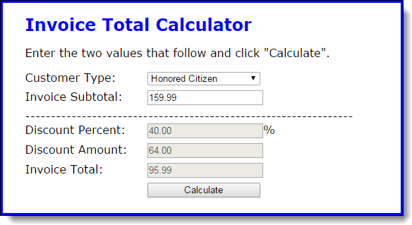
The user interface of the Invoice application

Slide 18
Some of the HTML for the application

Slide 19
Some of the HTML for the application (cont.)

Slide 20
The JavaScript for the Invoice application

Slide 21
The JavaScript (continued)

Slide 22
The JavaScript (continued)

Slide 23
The syntax for a try-catch statement

Slide 24
A try-catch statement for a calculateFV() function

Slide 25
A catch block that displays a custom message

Slide 26
Terms

Slide 27
The syntax for creating a new Error object

Slide 28
A calculateFV() method that throws a new Error object

Slide 29
A try-catch statement that catches the Error object that has been thrown

Slide 30
Some of the error types in the Error hierarchy

Slide 31
Two reasons for using throw statements

Slide 32
Two ways to create a regular expression object

Slide 33
Two statements that create a regular expression that will find “Babbage”

Slide 34
One method of a regular expression

Slide 35
How to create a case-insensitive regular expression

Slide 36
Terms

Slide 37
Special characters in regular expressions

Slide 38
How to match special characters

Slide 39
Types of characters in regular expressions

Slide 40
How to match types of characters

Slide 41
String positions in regular expressions

Slide 42
How to match string positions

Slide 43
How to group and match subpatterns

Slide 44
Repeating patterns in regular expressions

Slide 45
How to match a repeating pattern

Slide 46
Regular expressions for testing validity

Slide 47
Examples that use these expressions

Slide 48
A function that does complete validation of an email address

Slide 49
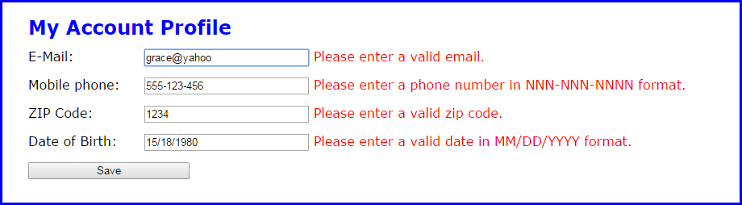
The Account Profile app with error messages

Slide 50
The HTML for the Account Profile application

Slide 51
The HTML (continued)

Slide 52
The JavaScript for the Account Profile application

Slide 53
The JavaScript (continued)

Slide 54
The JavaScript (continued)

Slide 55
Exercise 14-1 Enhance the Prime Number app

Slide 56
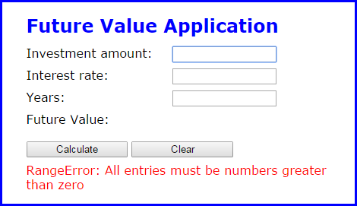
Exercise 14-2 Add exception handling to the Future Value application

Slide 57
Exercise 14-3 Enhance the Account Profile app

Slide 58
Extra 14-1 Develop a password generator

Slide 59
Extra 14-2 Enhance the validation for a date

Slide 60
Extra 14-3 Adjust a regular expression pattern

Slide 61
Short 14-1 Add a default subtotal value to the Invoice application

Slide 62
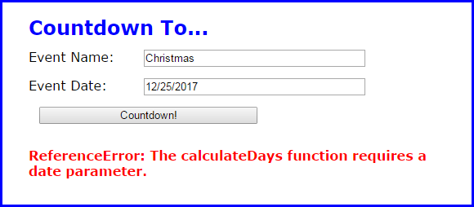
Short 14-2 Add exception handling to the Countdown application

